Slide 1
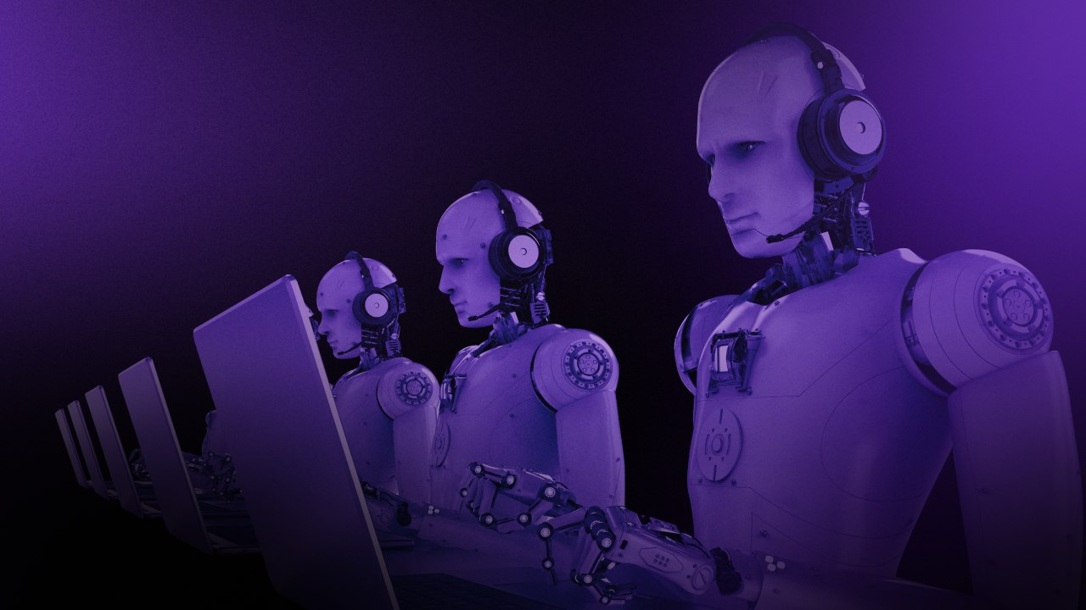

Slide 2
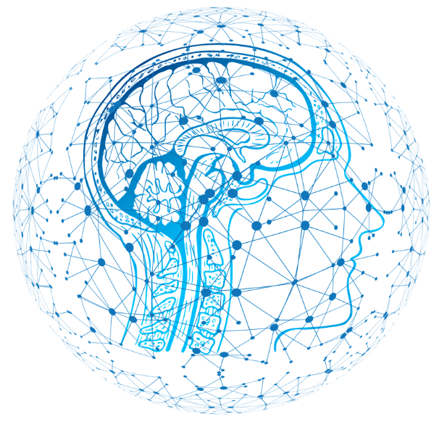
Artificial
intelligence
English Exchange with NTT

Slide 3
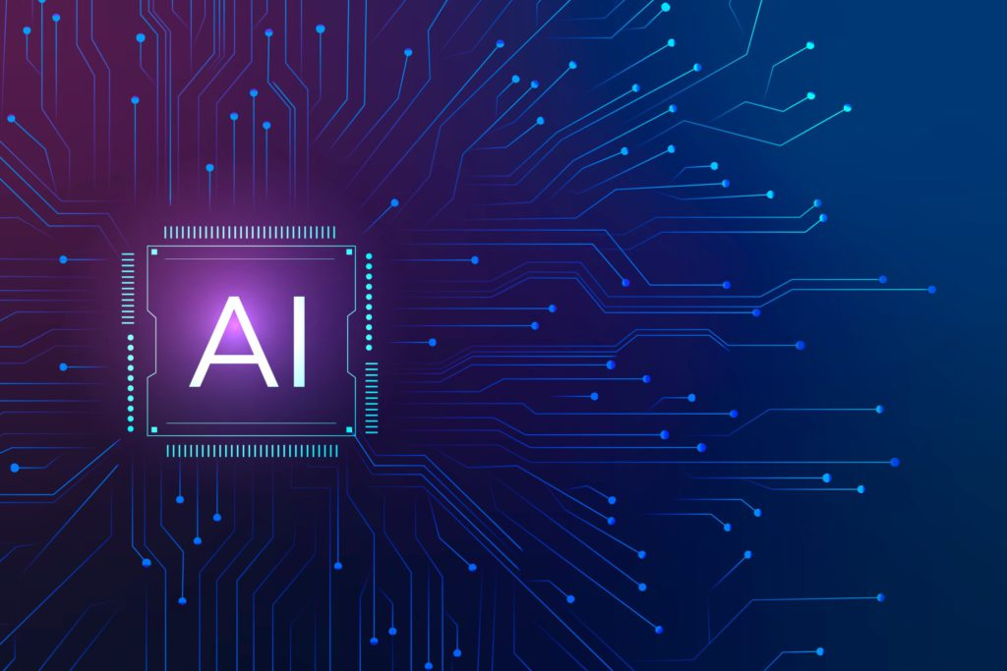
What are jobs that
can be replaced?

Slide 4

Customer Service representative
01
06
Retail Service
There ten job that can be replaced
Receptionist
02
07
Proofreaders and Translators
Accountants book keeper
03
08
Security and Military Personnel
Salespeople
04
09
Surgical Assistants
Taxi and Truck Driver
05
10
Courier Service

Slide 5

What are the indemand
jobs for AI?

Slide 6

There six indemand jobs in AI
01
Programming Skills
02
Libraries and Frameworks
03
Mathematics and Statistics
04
Machine learning and deep learning
05
Natural language processing and computer vision
06
Data science and data analysis

Slide 7

Conclusion

